Slide 1
What is your experience with intermittent water supply?
I’ve always had accessed to water at the tap
I visited a city where water was intermittent
I grew up in a town or city where water was intermittent

Slide 2
You just acquired a hotel in downtown Delhi, India
Electricity is intermittent, what do you do?
Water is intermittent, what do you do?
How can you get more water?
How does each affect your water quality?
Notes:
Rainwater
Storage tank on the roof
Pump (rob water from your neighbors and contaminate leaky pipes)
Well (wells in cities are prone to contamination)

Slide 3
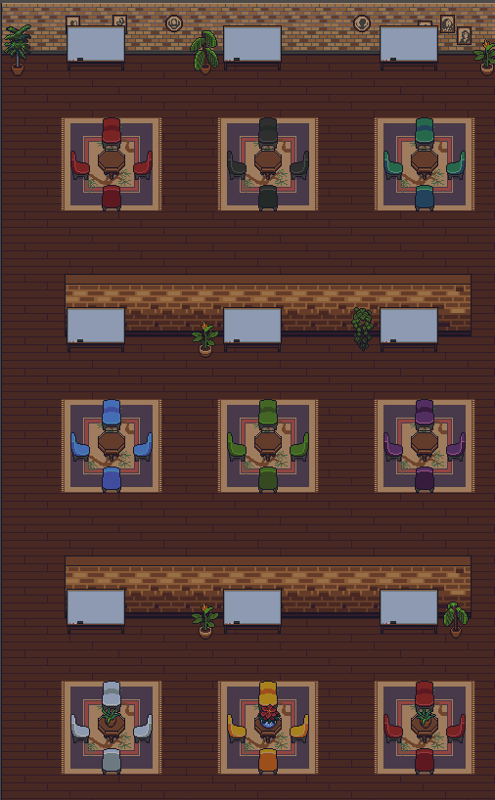
Playing with Onshape
How is Onshape coming along?
Go to the AguaClara office
Join a table with 2-3 other people (see how quickly you can do this!)
Create an account on GitHub
Post a demo issue at https://github.com/AguaClara/SWOT/issues
Discuss your progress learning Onshape around the table

